Slide 1
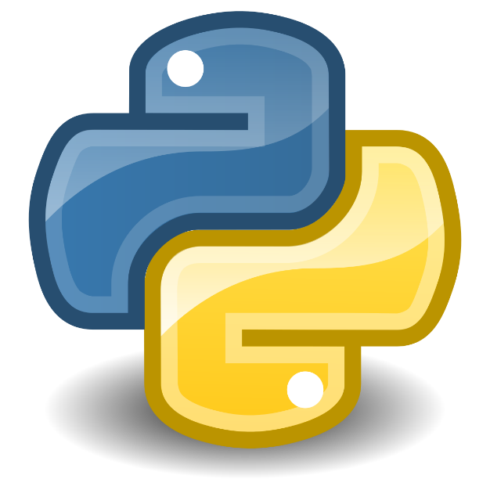
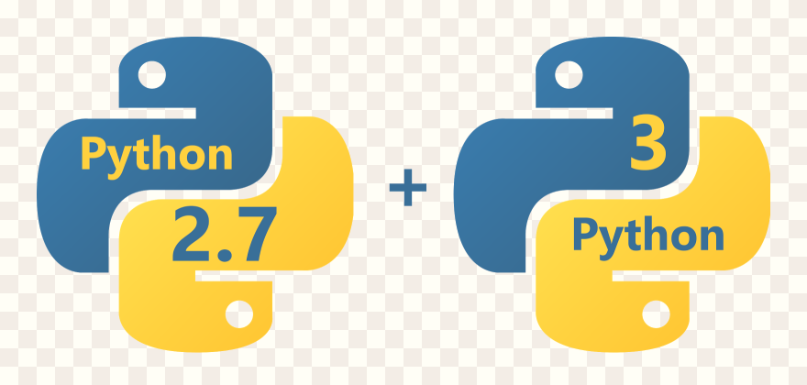
Introduction To Python
Prepared By: Dr. Ronak Panchal , Ph.D in Computer Science
IT Project Manager, Cognizant, Pune
Website blog: http://drronakpanchal.wordpress.com

Slide 2
Agenda
What is Python…?
History of Python
Why do people use Python?
Who uses python today
What can I do with python
JAVA vs Python & C vs Python
Python IDEs and Code Editors
Installing Python IDE
Python code execution
Python Web Technology
Demo (FLASK)

Slide 3
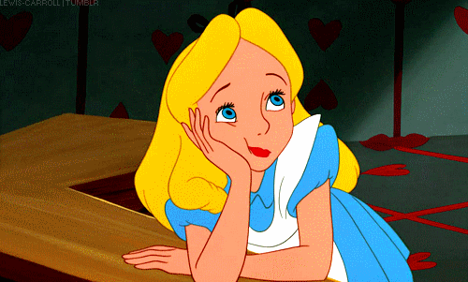
What is Python…?

Slide 4
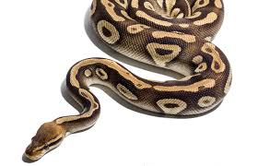
Not this python, unfortunately..!

Slide 5
What is Python?
Python is easy to use, powerful, and versatile, making it a great choice for beginners and experts alike.
Python is a general purpose programming language that is often applied in scripting roles.
So, Python is programming language as well as scripting language.
Python is also called as Interpreted language.
print("Python" + " is " + "cool!")

Slide 6
Differences between program and scripting language
Program
Scripting
A program is executed (i.e. the source is first compiled, and the result of that compilation is expected)
A "program" in general, is a sequence of instructions written so that a computer can perform certain task.
A script is interpreted.
A "script" is code written in a scripting language. A scripting language is nothing but a type of programming language in which we can write code to control another software application.

Slide 7
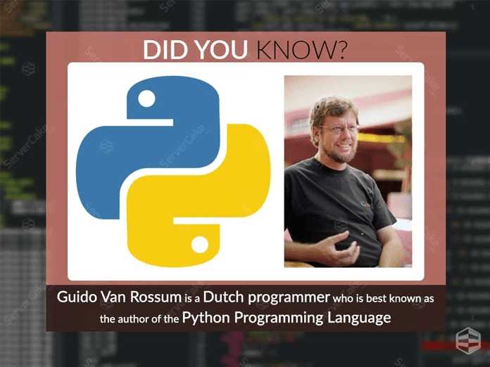
History of python
Invented in the Netherlands, early 90s by Guido van Rossum
Python was conceived in the late 1980s and its implementation was started in December 1989
Guido Van Rossum is fan of ‘Monty Python’s Flying Circus’, this is a famous TV show in Netherlands Named after Monty
Python Open sourced for the beginning

Slide 8
Why was python created?
"My original motivation for creating Python was the perceived need for a higher level language in the Amoeba [Operating Systems] project.
I realized that the development of system administration utilities in C was taking too long. Moreover, doing these things in the Bourne shell wouldn't work for a variety of reasons. ...
So, there was a need for a language that would bridge the gap between C and the shell”
- Guido Van Rossum

Slide 9
Why do people use Python…?
The following primary factors cited by Python users seem to be these:
“Life's better without braces” (Bruce Eckel)
It's free (open source): It is Downloading and installing Python is free and easy Source code is easily accessible
It’s Easy to learn and Has a Huge Community
Python is object-oriented : Structure supports such concepts like class,Ineritance, polymorphism, operator overloading, and multiple inheritance.
Indentation: Indentation is one of the greatest future in Python.

Slide 10
Why do people use Python…?
It's powerful
- Dynamic typing
- Built-in types and tools
- Library utilities
- Third party utilities (e.g. Numeric, NumPy, SciPy)
- Automatic memory management Indentation
It's portable
- Python runs virtually every major platform used today
- As long as you have a compatible Python interpreter installed, Python programs will run in exactly the same manner, irrespective of platform.

Slide 11
Why do people use Python…?
It's mixable
- Python can be linked to components written in other languages easily
- Linking to fast, compiled code is useful to computationally intensive problems
- Python/C integration is quite common
It's easy to use
- No intermediate compile and link steps as in C/ C++
- Python programs are compiled automatically to an intermediate form called
bytecode, which the interpreter then reads
- This gives Python the development speed of an interpreter without the
performance loss inherent in purely interpreted languages
It's easy to learn
- Structure and syntax are pretty natural and easy to grasp

Slide 12
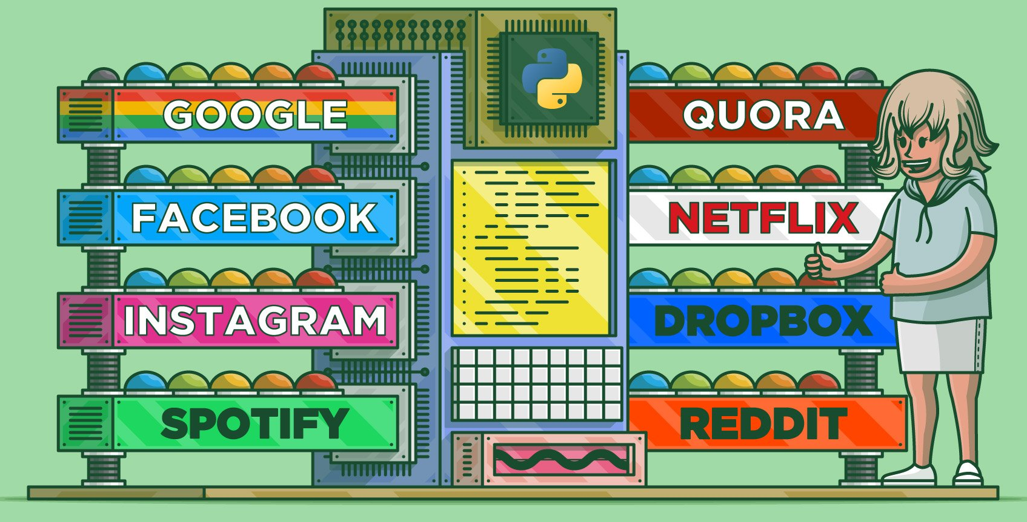
Famous company whose use python
Source: https://realpython.com/world-class-companies-using-python/

Slide 13
Cool Things you can do with Python
Scientific and Numeric Computing
Python Makes Robotics Possible
Creating bots and Scraping websites
Data Science, Machine Learning, data visualization, and analysis
Web Development with frameworks like Django and Flask
Browser Web Application Automation and Web Scraping
Game development with Pygame
Mobile apps with frameworks like Kivy
And many more…

Slide 14
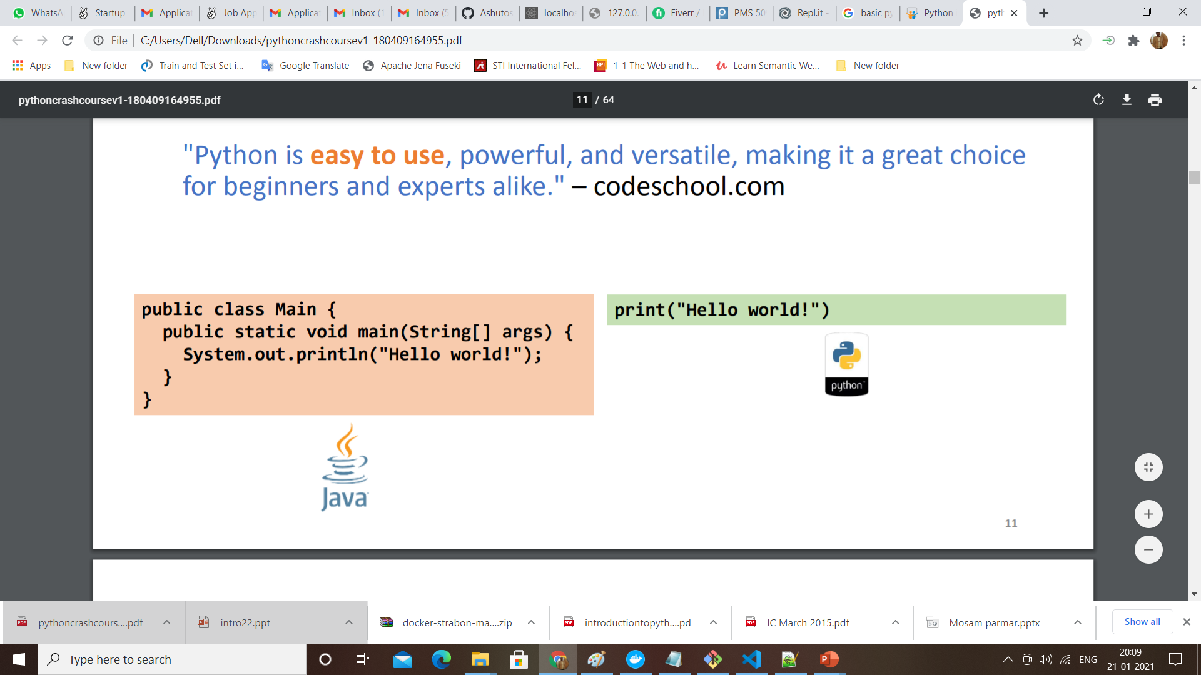
JAVA vs Python
Java is compulsory to declare the datatype of variables, array etc.
Its type discipline is static and weak.
Java has switch statement.
The array index should be a positive integer.
Indentation of statements is not necessary in JAVA.
Type declaration is not required in python.
Its type discipline is dynamic and strong.
Python does not have switch statement.
Array index can be positive or negative integer number. Negative index represent location from the end of the array.
Indentation is required to represent a block of statement.

Slide 15
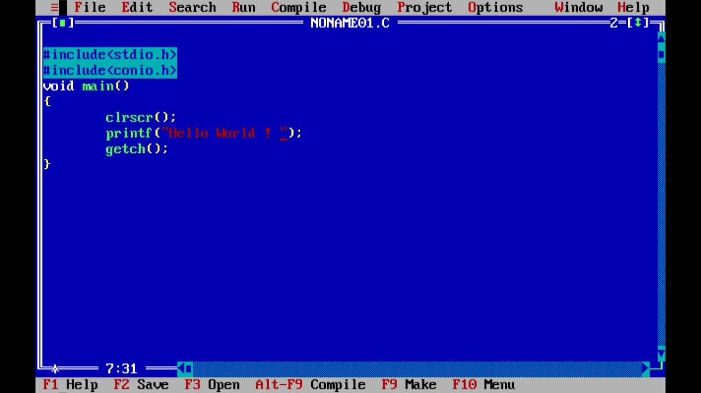
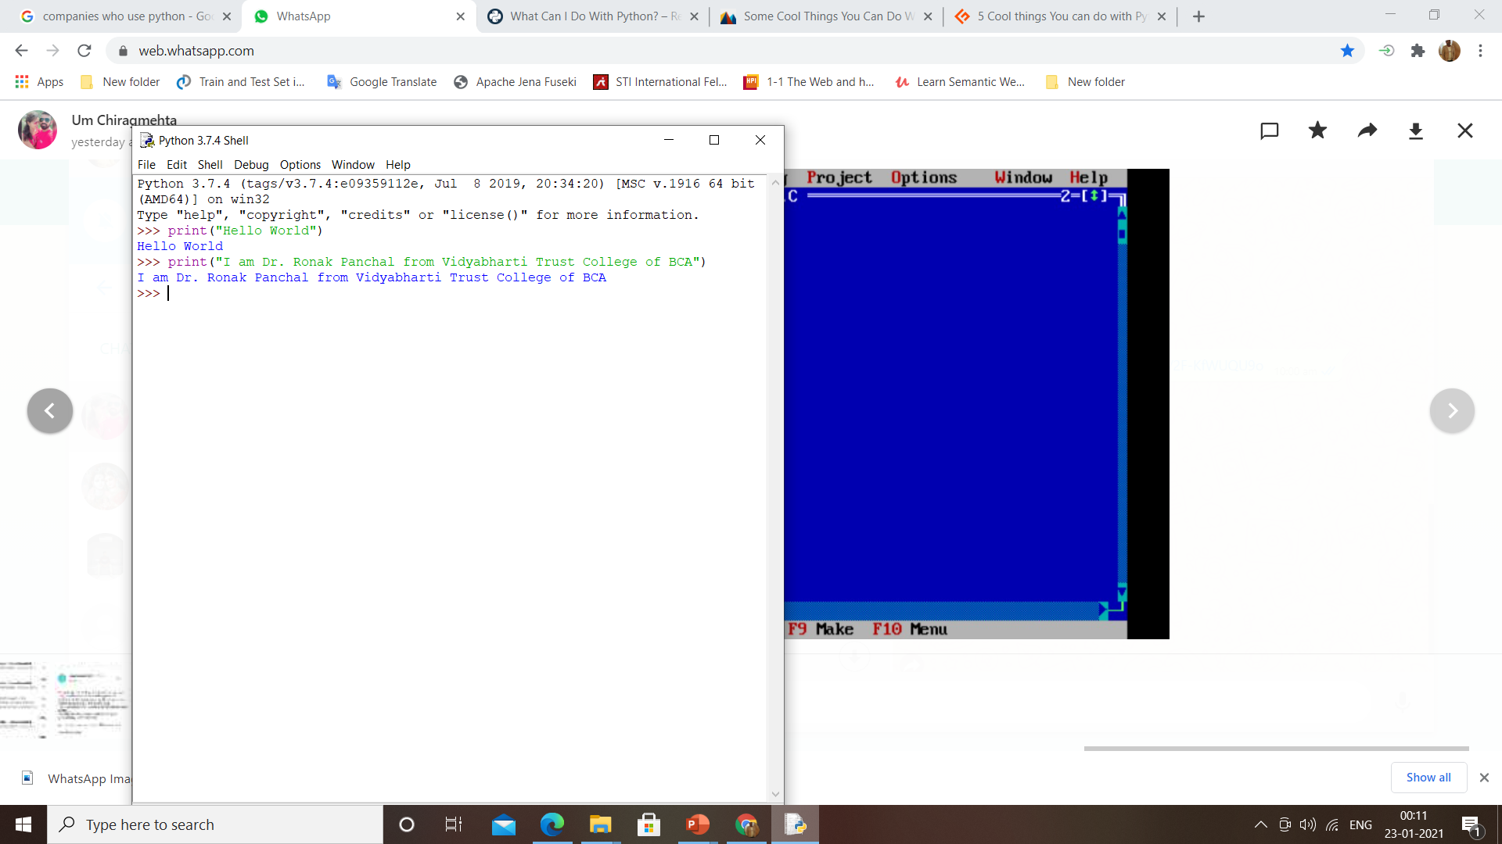
C vs Python
C
Python
C is procedure-oriented programming language. It does not contain features like classes, objects, inheritance, polymorphism etc.
Pointer concept is available in C.
C does not handles exceptions and hence C program are weak.
The variable in for loop does not increment automatically.
Python is object-oriented programming language. It contains features like classes, objects, inheritance, polymorphism etc.
Python does not use pointer concept.
Python handles exceptions and hence python program are robust.
The variable in for loop increments automatically.

Slide 16
Python IDEs and Code Editors
Python IDLE
Sublime Text 3
Atom
Thonny
PyCharm
Visual Studio Code
Vim
Spyder
Anaconda
Online Compiler from Programiz - https://www.programiz.com/python-programming/online-compiler/
REPL stands for Read-Eval-Print-Loop - an interactive, typically console-based, programming - https://repl.it/new/python3 which is integrated with github
Source: https://www.programiz.com/python-programming/ide

Slide 17

Time To Start Installation

Slide 18
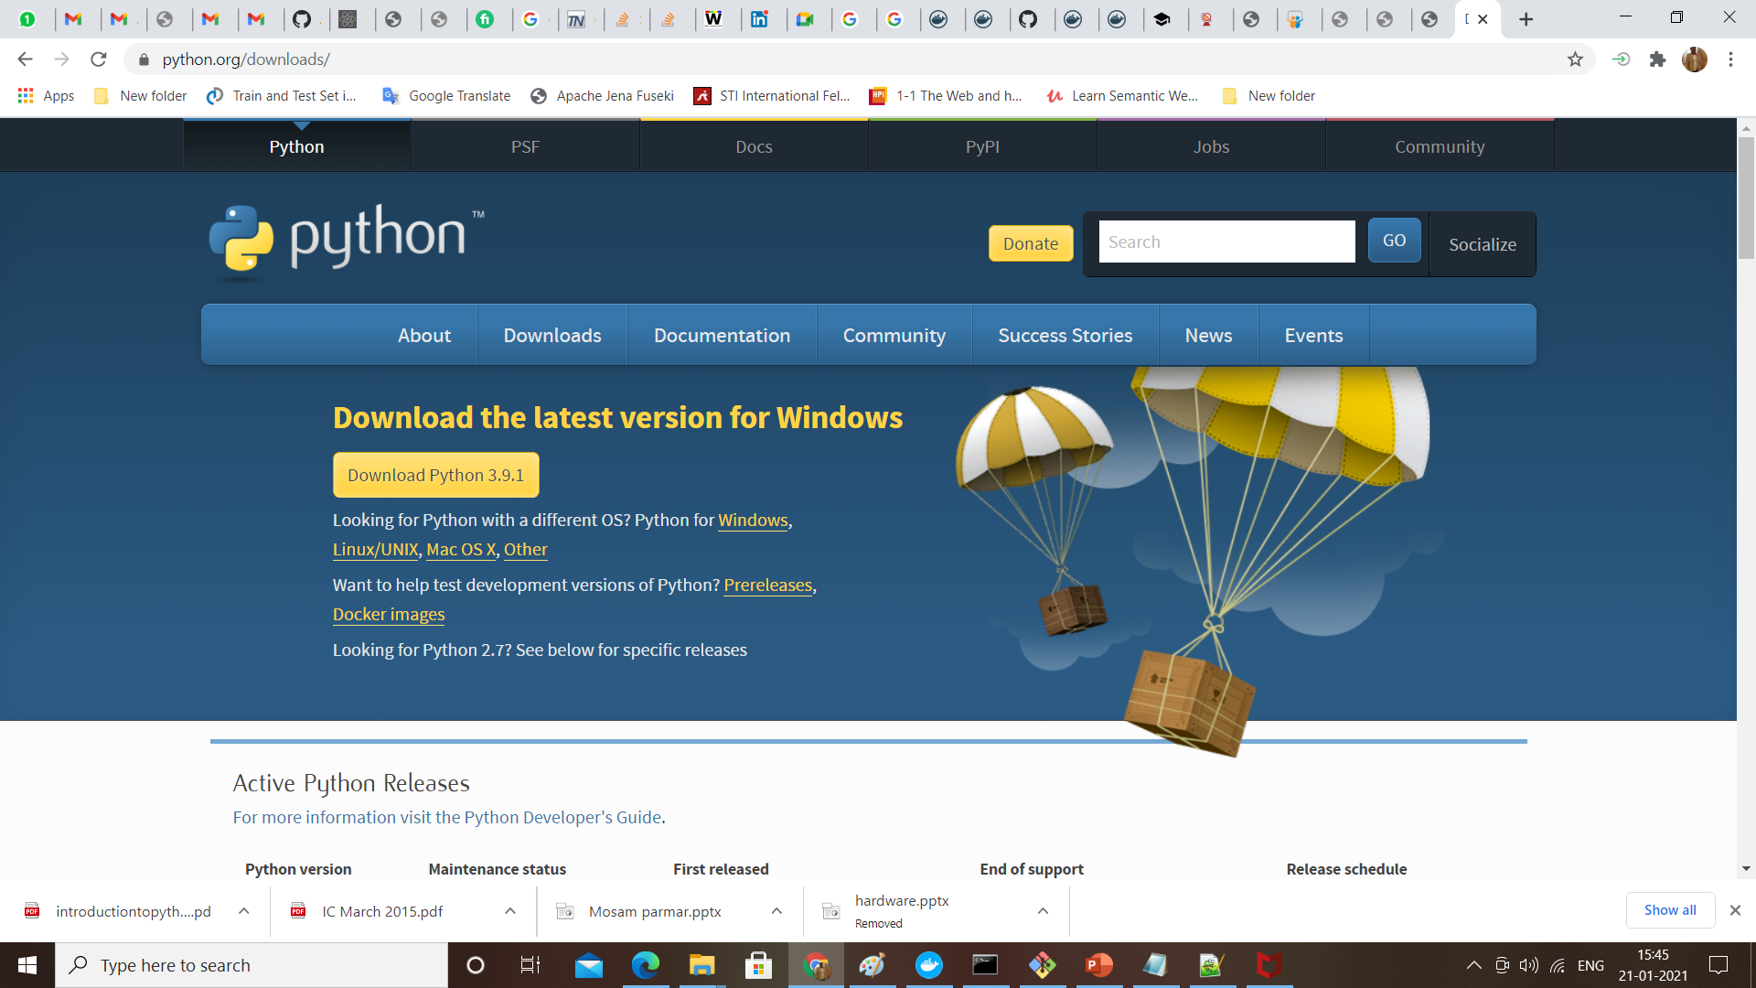
Installing Python
Current Version: 3.9.1
Python is pre-installed on most Unix systems, including Linux and MAC OS X
But for in Windows Operating Systems , user can download from the https://www.python.org/downloads/
from the above link download latest version of python IDE and install, recent version is 3.9.1 but most of them uses version 2.7.7 only

Slide 19
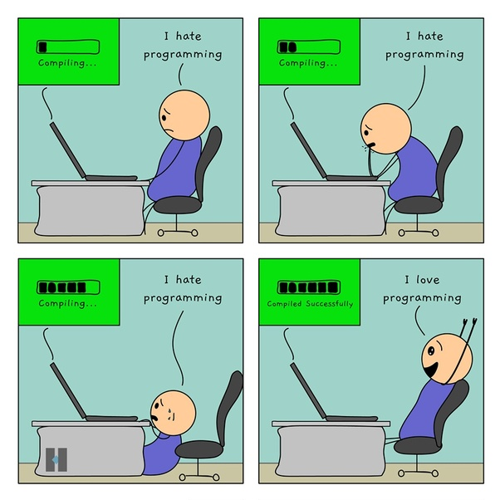

Slide 20
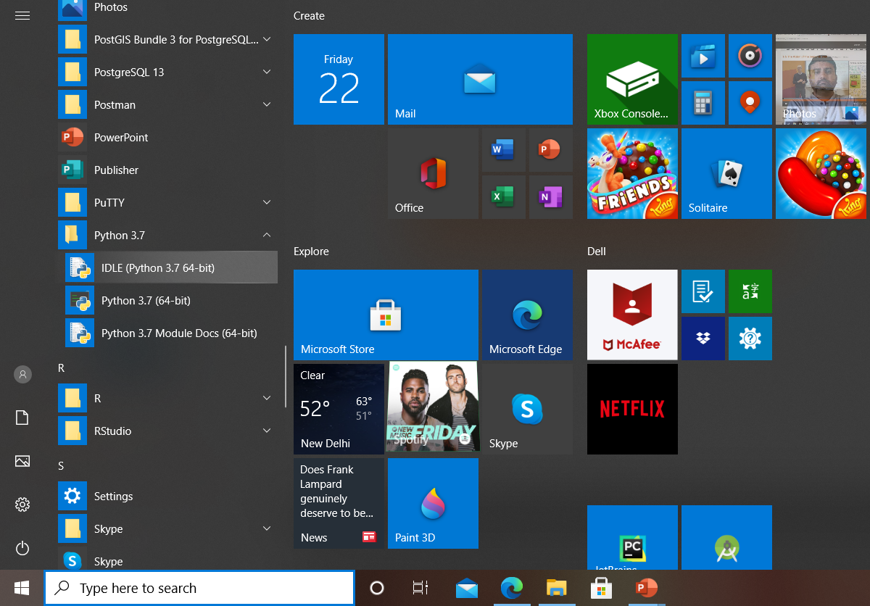
How to find python in windows
Once installation is completed.
Go To All Program
Click on Python IDLE

Slide 21
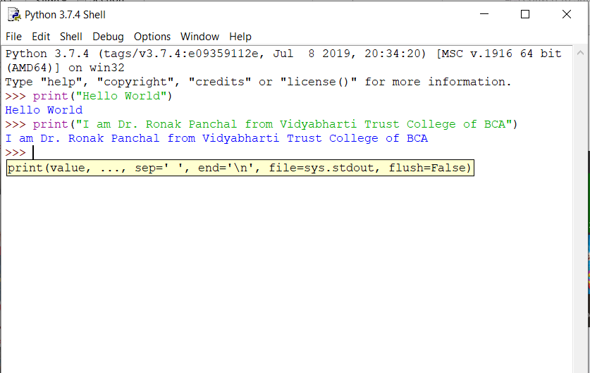
Now see first screen of Python IDLE

Slide 22
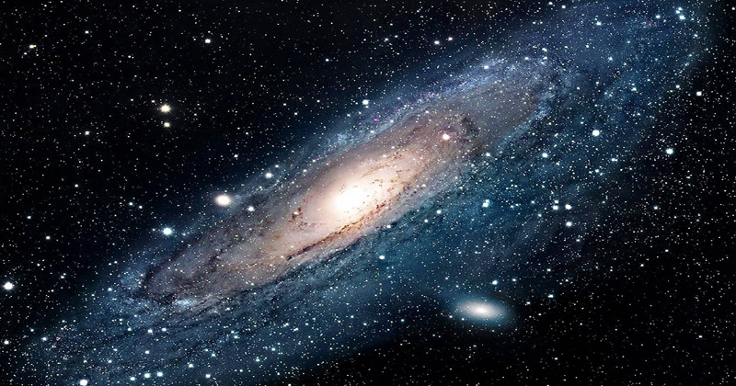

Let’s explore the universe

Slide 23
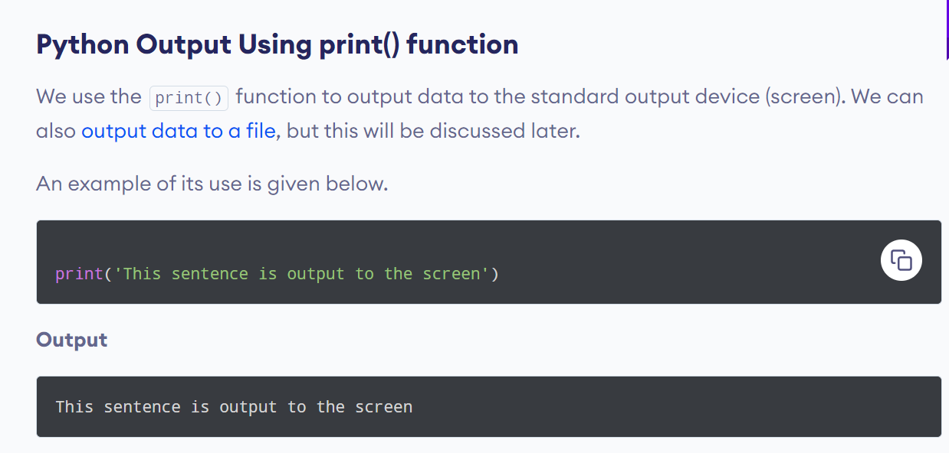

Slide 24
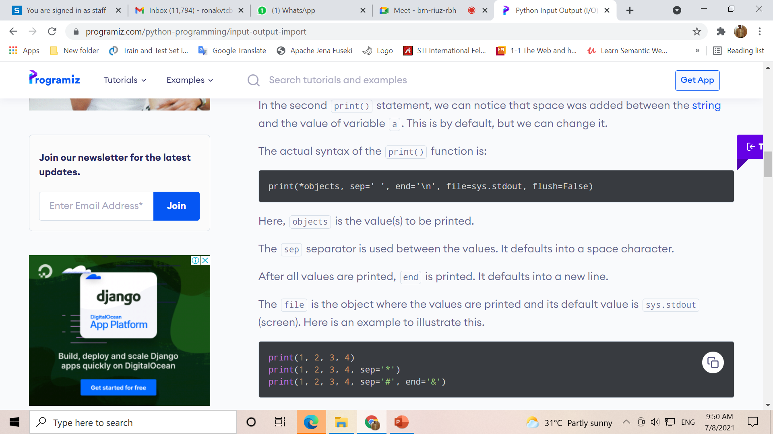

Slide 25
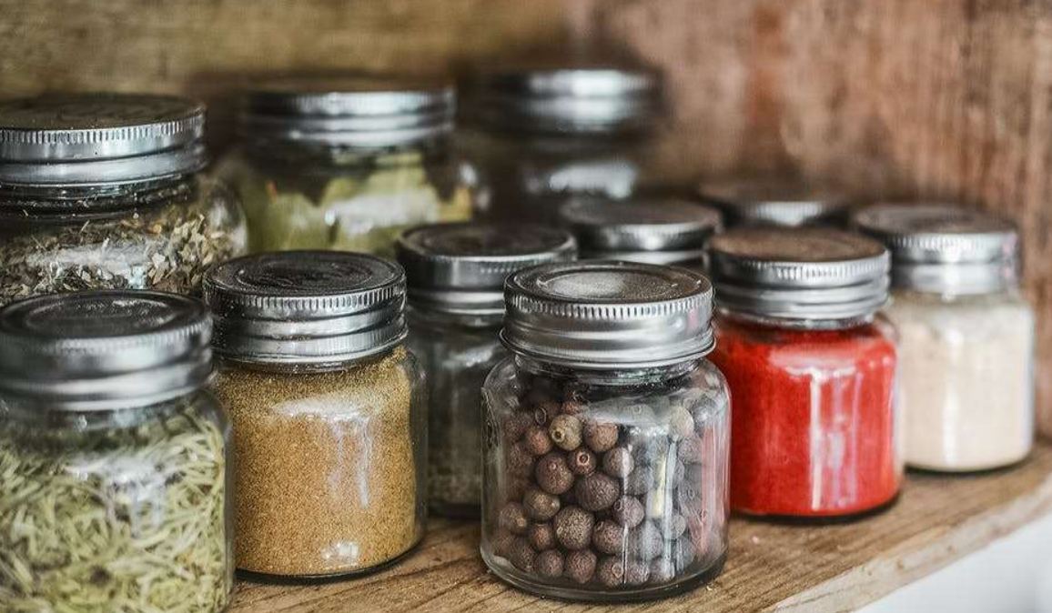
Variables and Data Types in Real Life

Slide 26
Variable
No need to declare
Need to assign (initialize)
use of uninitialized variable raises exception
Not typed
if friendly:
greeting = "hello world"
else:
greeting = 12**2
print greeting
Everything is a "variable":
Even functions, classes, modules
Type statements or expressions at prompt:
>>> print "Hello, world"
Hello, world
>>> x = 12**2
>>> x/2
72
>>> # this is a comment

Slide 27
Data Types
Variables store and give names to data values
Data values can be of various types:
int : -5, 0, 1000000
float : -2.0, 3.14159
bool : True, False
str : "Hello world!", "K3WL"
list : [1, 2, 3, 4], ["Hello", "world!"], [1, 2, "Hello"], [ ]
And many more!
In Python, variables do not have types!
Data values are assigned to variables using "="
x = 1 # this is a Python comment
x = x + 5
y = "Python" + " is " + "cool!"

Slide 28
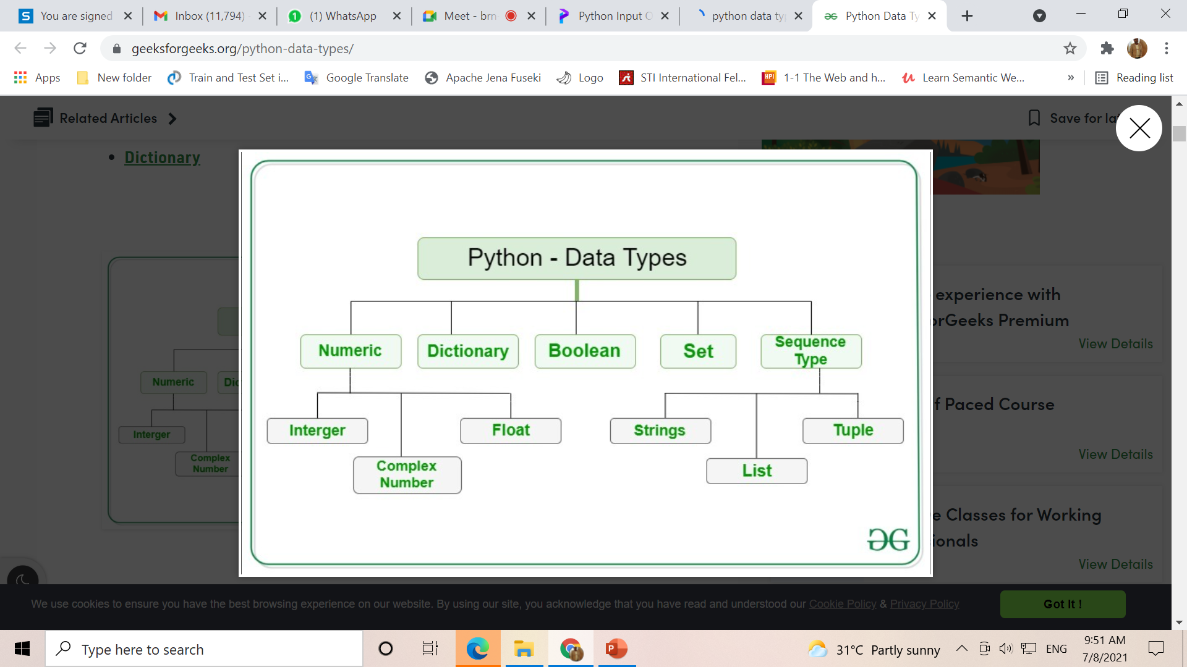

Slide 29
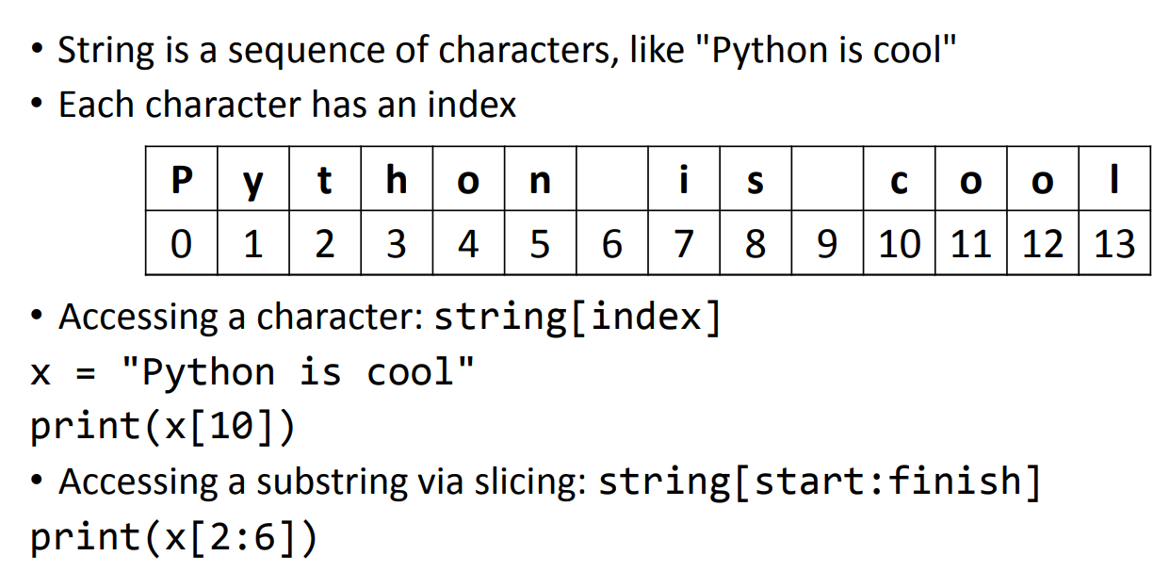
Basic string

Slide 30
Basic string operation
“hello”+”world” “helloworld” # concatenation
"hello"*3 "hellohellohello" # repetition
"hello"[0] "h" # indexing
"hello"[-1] "o" # (from end)
"hello"[1:4] "ell" # slicing
len("hello") 5 # size
"hello" < "jello" 1 # comparison
"e" in "hello" 1 # search
"escapes: \n etc, \033 etc, \if etc"
'single quotes' """triple quotes""" r"raw strings"

Slide 31
Conditional Statements
The if statement
The if else statement
Chained conditionals
Nested if

Slide 32
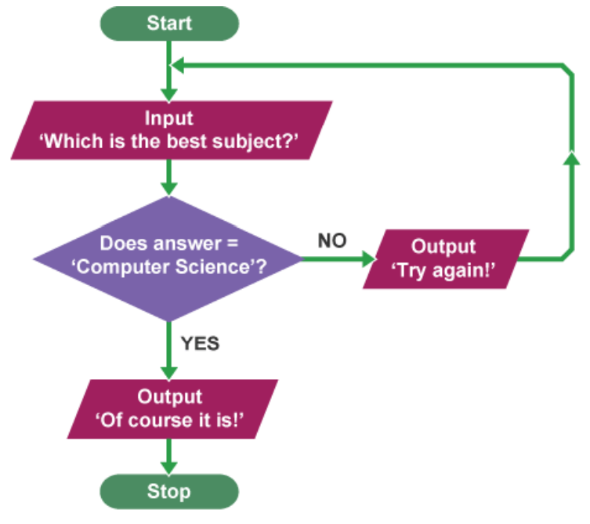
Conditionals and Loops
if condition:
statements
[elif condition:
statements] ...
else:
statements
while condition:
statements
for var in sequence:
statements
break
continue

Slide 33
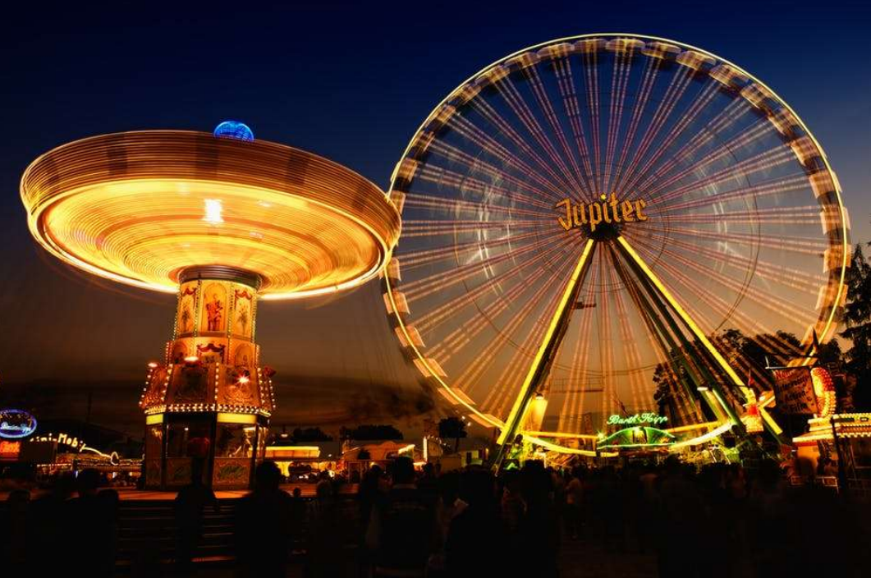
Conditionals and Loops in Real Life

Slide 34
Loop / Iteration
A loop is syntax structure that repeats all the statements within the loop until the exit condition is met.
While..
For loop

Slide 35
Conditionals: Generic Form
if boolean-expression-1:
code-block-1
elif boolean-expression-2:
code-block-2
(as many elif's as you want)
else:
code-block-last

Slide 36
Conditionals: Driving license age
age = 20
if age < 18:
print(“Not Eligible!")
else:
print("OK, Eligible.")

Slide 37
Conditionals: using Input
age = int(raw_input(“Enter Age: "))
# use input() for Python 3
if age < 18:
print(“Not Eligible!")
else:
print("OK, Eligible.")

Slide 38
Conditionals: Grading
grade = int(raw_input("Numeric grade: "))
# use input() for Python 3
if grade >= 80:
print("A")
elif grade >= 65:
print("B")
elif grade >= 55:
print("C")
else:
print("E")

Slide 39
Loops
Useful for repeating code!
Two variants:
while boolean-expression:
code-block
for element in collection:
code-block

Slide 40
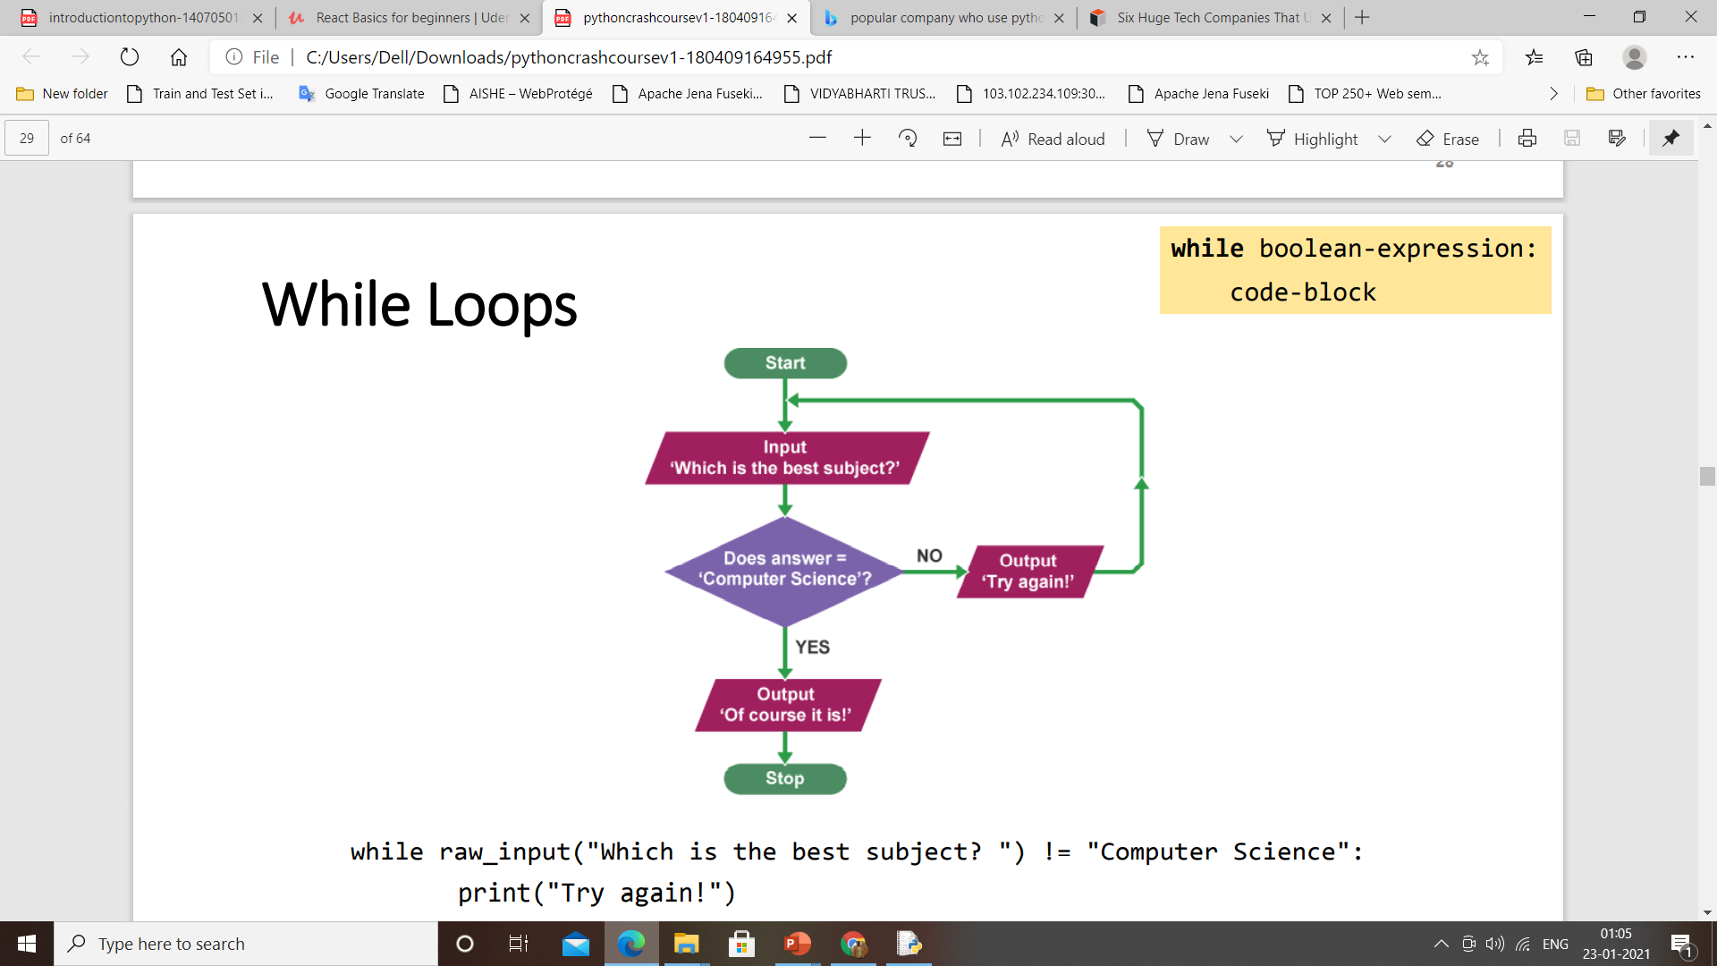
While Loop
while raw_input("Which is the best subject? ") != "Computer Science": print("Try again!")
print("Of course it is!")

Slide 41
For Loops
So far, we have seen (briefly) two kinds of collections: string and list
For loops can be used to visit each collection's element:
for chr in "string":
print(chr)
for elem in [1,3,5]:
print(elem)

Slide 42
Functions
Functions encapsulate (= membungkus) code blocks
Why functions? Modularization and reuse!
You actually have seen examples of functions:
print()
raw_input() or input() [up to version 3]
Generic form:
def function-name(parameters):
code-block
return value

Slide 43
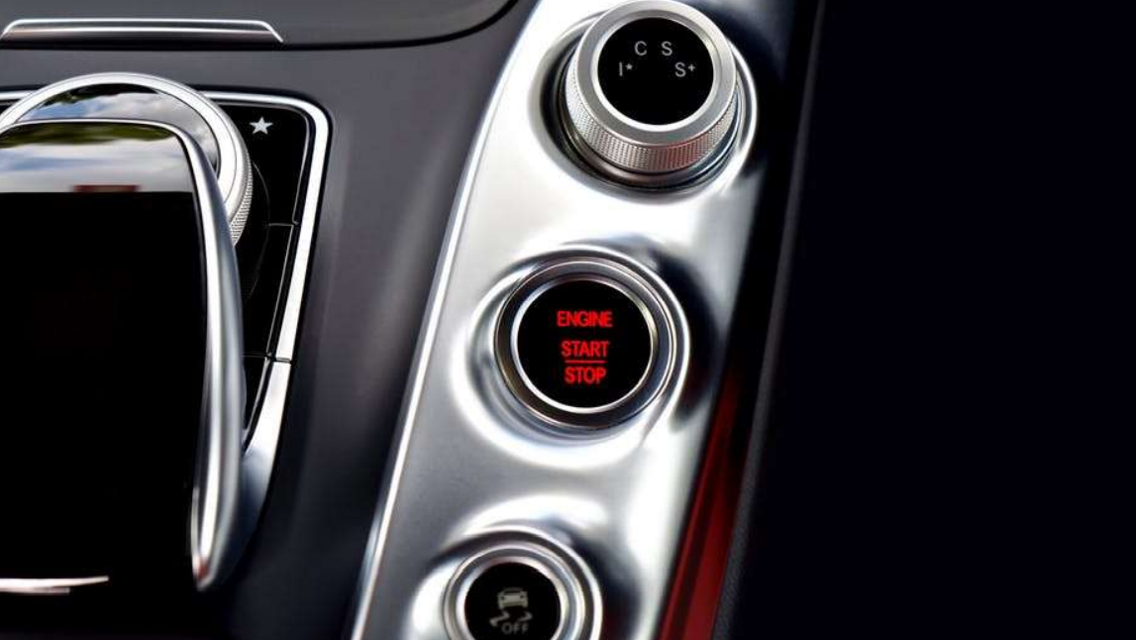
Functions in Real Life

Slide 44
def hello(name_man="Bro", name_woman="Sis"):
print("Hello, " + name_man + " & " + name_woman + "!")
>>> hello()
Hello, Bro & Sis!
>>> hello(name_woman="Lady")
Hello, Bro & Lady!
>>> hello(name_woman=“Maria",name_man=“John")
Hello, John & Maria!

Slide 45
Functions: Celcius to Fahrenheit
def function-name(parameters):
code-block
return value
def celsius_to_fahrenheit(celsius):
fahrenheit = celsius * 1.8 + 32.0 return fahrenheit

Slide 46
Imports statement
Code made by other people shall be reused!
Two ways of importing modules (= Python files):
Generic form: import module_name
import math
print(math.sqrt(4))
Generic form: from module_name
import function_name from math
import sqrt
print(sqrt(4))

Slide 48
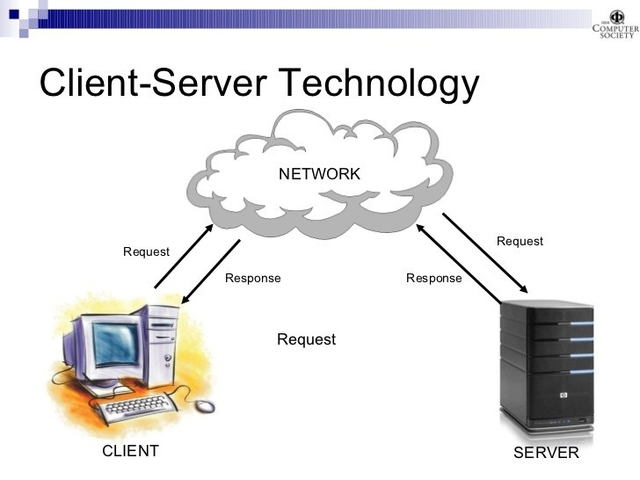
Python Web Technology
What is web technology?

Slide 49
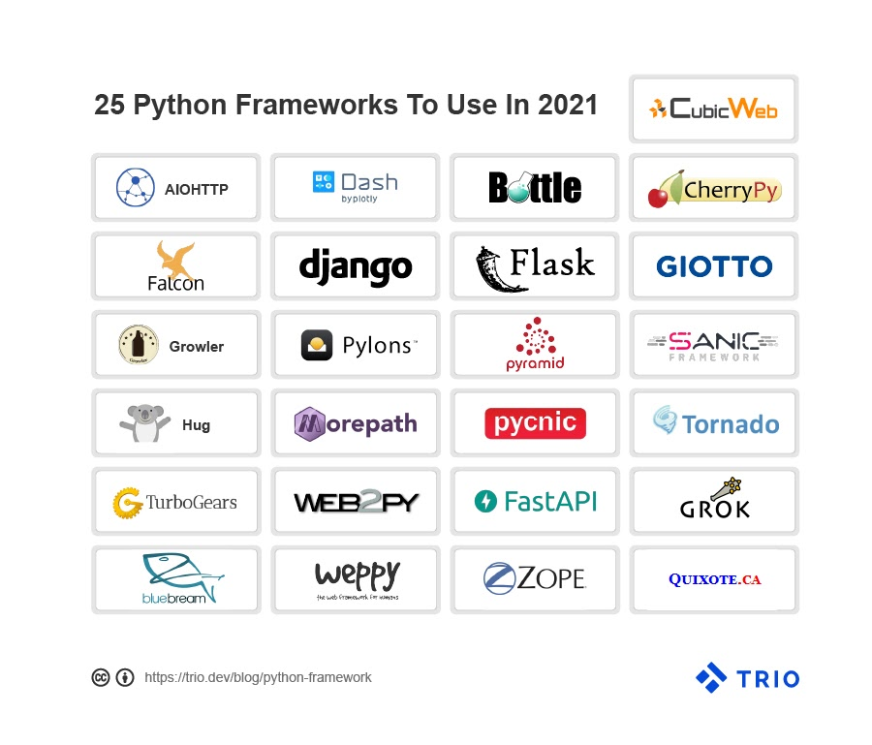

Slide 51
Flask Web Framework
Flask is the Python Based Web development framework classified as the Micro Framework because it does not require any particular library or tool.
Along with that, it does not include form validation, neither hold database abstraction layers nor demand any specific third party libraries. But, it gives you complete flexibility to plug in any extension and also build your own modules. So, if you are really looking for prototyping, Python Flask is the most desirable choice.
It contributes significantly in providing strong support as a fast debugger and built-in developer server that together delivers a seamless performance.

Slide 52
What is Python Flask good for?
It offers an integrated support for unit testing
WSGI 1.0 compliant that forward requests from a web server to a backend
It supports in implementing the RESTful request dispatching
Python Flask is Unicode based that assign code to every language and symbol

Slide 53
Django
Django is a Python Based Model-View-Template Framework for web development. This platform is developer-friendly and ensures convenience in case of data driven or complex web development projects. Here, programmers can write clean, readable and maintainable code during a web app development.
Who uses Django?
Instagram, Google, Quora and YouTube are using Django since it offers advanced features rich with authentication, security and messaging.
Is Django Frontend or backend?
Django is suitable for both frontend and backend development services

Slide 54
Django Framework
Is Django Fast? Is Django worth learning in 2020?
It is designed mainly to create scalable websites and manage the heaviest traffic demands that make Django so impressive. Moreover, it is quite easy to learn and understand so this is beginner’s friendly.
What is Django good for?
It is SEO Optimize and holds an edge over other frameworks
Logical project structure and MVT architecture make it versatile
It provides a rapid development process
Offers excellent documentation in the market

Slide 55
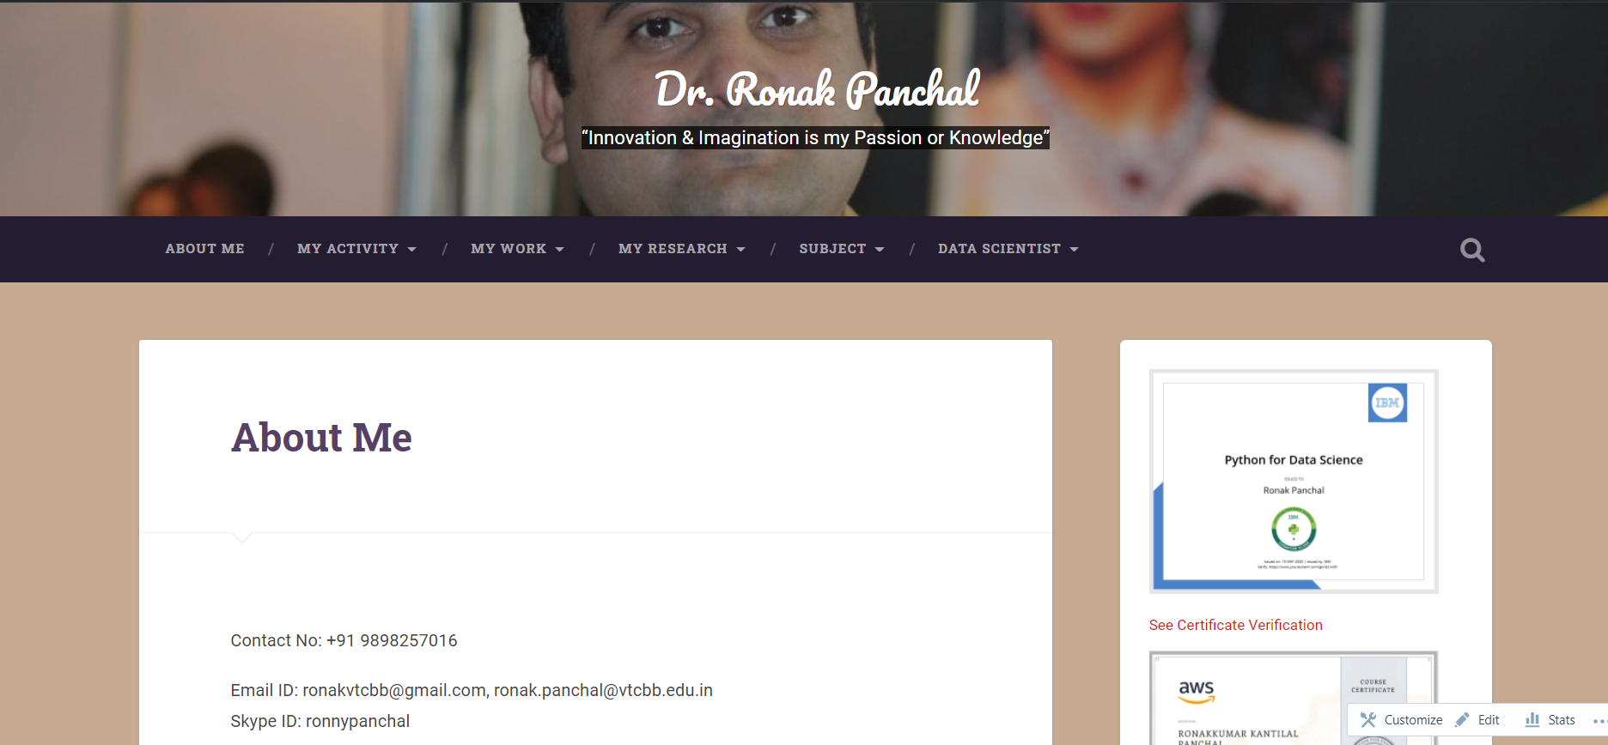
This Is My WordPress Blog
https://drronakpanchal.wordpress.com/

Slide 56
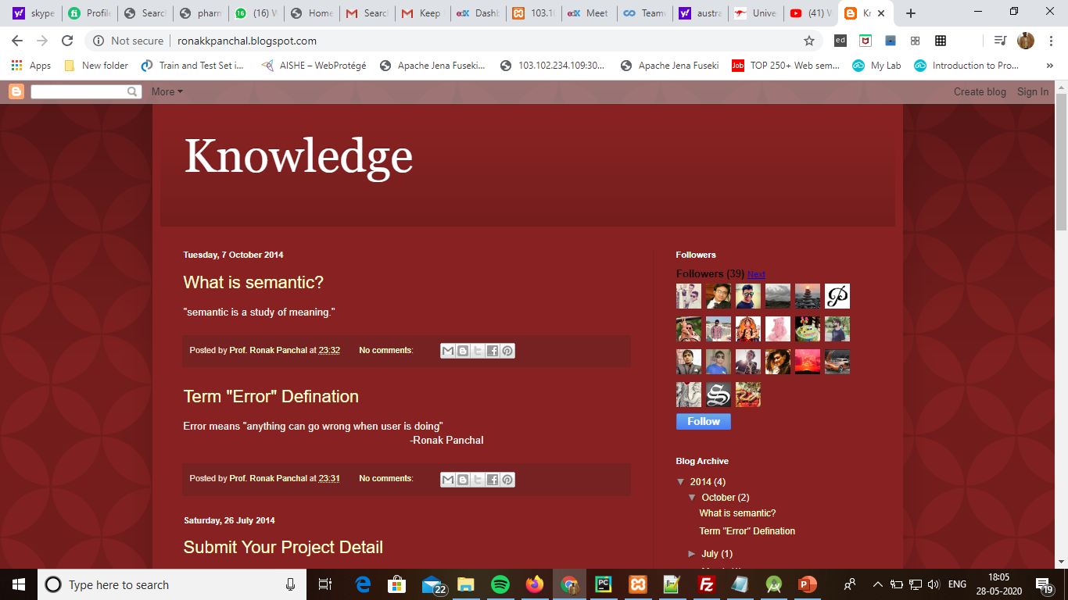
my first blog

Slide 57
Thank You Question & Answer

